Slide 1
2WAY FM 3 year Strategy Deck
2Way FM Board of Management SEPTEMBER 2024

Slide 2
Mission
A
At 2WAY FM we empower our presenters to foster a genuine connection with the local community through their programs aimed at being informative and entertaining and delivering something that commercial stations do not cover.

Slide 3
Vision- Why
Improve the wellbeing of Hastings Valley and neighboring communities (three valleys: Hastings, Macleay and Manning) through our informative and entertaining programming, provided by locals for locals.
Be a friend of our listener.

Slide 4
Values – Manifesto
Live And Local
We are part of the community and exist to serve the community in providing local relevant content which entertains and informs. We will champion for our listeners to give them what they want to hear.
All Day Every Day
We strive to have live broadcasts daily throughout most of the day and be responsive to community engagement and listen to their views
$
Only on 2WAY FM
We strive to be the best in everything we do. Fairness to our presenters, open with our members, supportive of our sponsors, authentic and caring of our listeners.

Slide 5
3 YEAR PLAN

Slide 6
Swot Analysis
STRENGTH
WEAKNESS
INTERNAL
Process
Not knowing listeners stats.
Internal communication
Recognition of presenters
Socialisation – social family- members and presenters
KPI’s for BOM and 2WAY FM
Promotion
Demographics – age cultural
Marketing
Membership benefits – sponsors discounts, membership draws, bumper sticker
Purpose
Variety
Community Minded
People
Presenters
Longevity
Friendly Listener Rapport
Location
Programming
Listener Demographics
Live and Local, All day Everyday
Local News
Process
Solid Mgt Committee
Promotion
Population size
Loyal Sponsors
Purpose
Funding
Reliance on sponsorships
People
Human Resources
Ageing presenters
Younger listeners
Programming
Expertise skill level
POSITIVE
NEGATIVE
Purpose
Focus groups
People
Members Day
Programme
Outside broadcast
Podcast
Online Audio
Process
Training facility for local news
Promotion
School’s out program
Events Calander
Community events ( ie national volunteer week)
Seniors week
Careers week
St Patricks Day
Mother’s Day promotion
Purpose
Pandemic Bird Flu
Fire Floods
Temperature
Viability
Economic changes
People
Ageing presenters
Programme
Equipment Breakdown
New technology
Technology
Entertainment options
Process
Security
Promotion
Listener preferences
EXTERNAL
OPPORTUNITIES
THREATS

Slide 7
SWOT ANALYSIS
How our Presenters See Us. Key Outakes
Key Issues
Poor recognition of presenters
Funding relies on sponsors
Skill level of presenters
Equipment failure
Key Opportunities
Members day
Annual Events Calander
Outside broadcasts
Schools and training programs
Key Thrusts
Purpose – financial stability
People- recognition, community engagement
Program – Maintenance Schedule
Process – KPIs, Procedures, Brand Guideline
Promotion – OB, Stickers, Events

Slide 8
5 Key Thrusts
PURPOSE - IM
Branding -Website and other assets need upgrading
Financials
Sponsorships 20%
Grants X%
Fundraising 40%
Memberships 10%
PEOPLE - KL
Audience ( 65-80) Comprises of 30% demographic and is steady, engage younger audience ( 40+) and community
Presenters We have 55 presenters average age is 60 and we rely on them to do most of the fundraising- celebrate our presenters with more recognition and members day
PROGRAM – AC/JW
Broadcasting equipment may be coming to end of serviceable life and need to upgrade / maintain as well up train others.
Maintenance Schedule – needs to be implemented across all assets
PROCESS – GH
Policies and Procedures Some are outdated and need formatting and consistence filing
KPI- Currently Committees have no KPI’s which is needed for effective resource mgt and accountability
PROMOTION – DO
Events Set up an events calendar and have regular promotions as well as Outside broadcasting
Merchandising- bumper stickers, caps, tote bags, revise inventory and select.
Costs
Electricity 20%
Radio Tower Rental 20%
?

Slide 9
Purpose – IM
Branding
Website Update July-Dec 24
Brand book – July 24
Increase social media and content July-Dec 24
Financials
Financial analysis of all key revenue and cost streams
Assets Registers
Review all assets and identify replacement time frame
Transmission and Broadcast
Survey and ensure all elements are working and proper maintenance schedule November 2024

Slide 10
People – KL
Audience
Presenters
Community engagement
In crease by 10 %
Satisfaction survey %
Engagement Hours pa %
Conduct regular tracking across all key demographics on a biannual basis
Track audience growth or share of younger audience
Conduct biannual satisfaction survey
Provide regular Presenters newsletter, making fun, enjoyable and a resource.
Appoint community engagement officer
Areas for community connections
Specifically targeted engement to reach out to other groups ie schools, charity organisations etc
Increase social media and content

Slide 11
Programme – AC/JW
Audit and Map and review status of all key / critical components
Establish Maintenance schedule for all key critical assets.
Back up training for key technical staff.

Slide 12
Process – GH
POLICIES AND PROCEDURES
Update policies in consistent format
Consistent numbering
Position descriptions
KPI’s
Every Position to have KPI’s and review period
Resource Efficiency/Efficacy
Review our resources: finances and other are fit for purpose.
12

Slide 13
Promotion – DO
Events
Establish Events Calander
OB plan / equipment
Radiothon and other fundraising activities
Merchandise
Complete audit of all assets
Suggests most appropriate ie bumper stickers
$
Marketing & Sponsorship Manager
Manage all marketing assets
Social Media
Organise Merchandise
Update Website

Slide 14
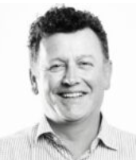
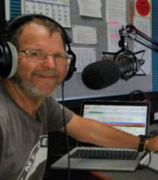
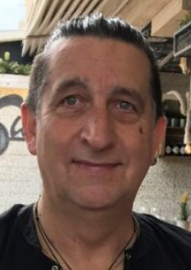
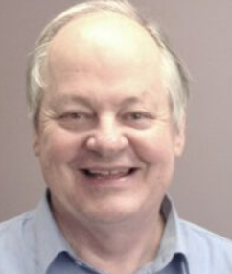
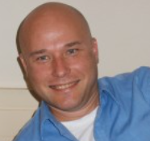
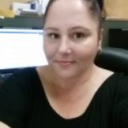
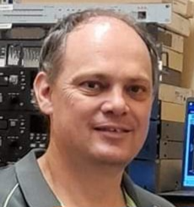
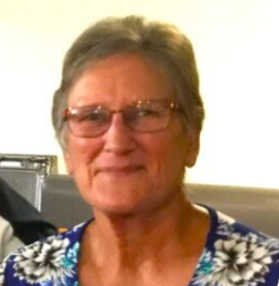
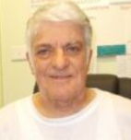
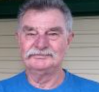
The full team ☺
Iljko Miocevic
Ken Lindsay
Greg Hayward
Dennis Owen
Andrew Clements
President
Vice President/ Programing
Treasurer / Sponsorship
Secretary / Events
Audio Production
Beverly Cole
Rex De Saxe
James Wallis
Liz Faassen
To be selected
Admin Support
Maintenance
Broadcasting & Transmission
Marketing & Sponsorship
Community Engagement
Ross Cutrupi

Slide 15
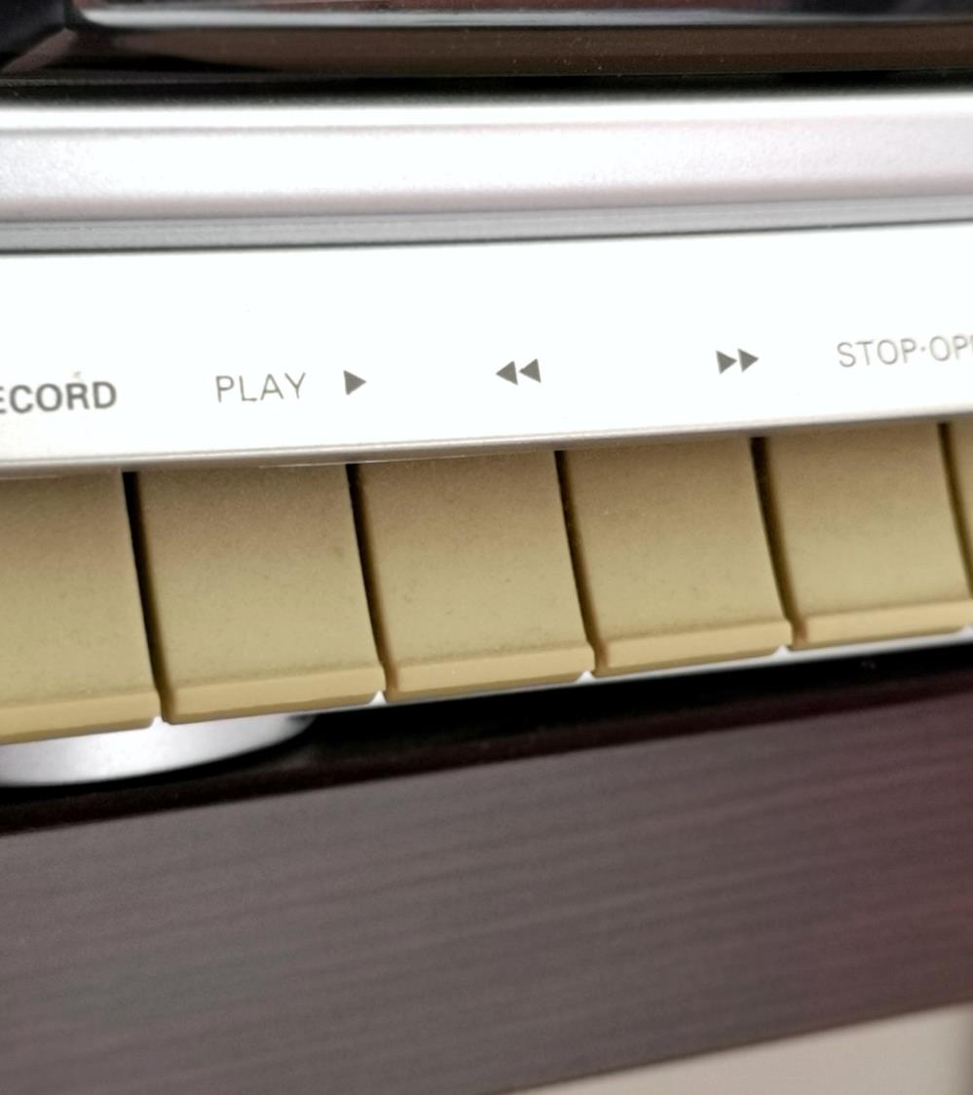
Summary on a page
Over the next 3 years our key themes and objectives will be
Purpose – double our finances and brand awareness
People- represent our presenters and increase our community engagement, whilst increasing our audience by 20% . Establish vibrant engagement with presenters.
Program – Improve our broadcasting resilience supported by a rigid maintenance schedule, repair, replace, overhaul what’s needed.
Process – Develop and implement KPIs, Procedures, Brand Guideline
Promotion – Develop our OB capabilities, engage in an events calendar and produce relevant merchandise material and fundraising events

Slide 16
Thank You
LIVE and LOCAL,
All Day, Every Day

